Slide 1



Baseline Assessment of antimicrobial stewardship Practices At AAR Hospital(Private Facility),Findings from Aspire Project.
Dr Diana Kariuki, Pharmacist AAR Hospital

Slide 2
Background
Antimicrobial resistance (AMR) poses a major public health threat in Kenya, with sub-Saharan Africa carrying a disproportionate burden. In Kenya, AMR is driven by antibiotic overuse in healthcare, agriculture, and unregulated over-the-counter sales. Hospitals, especially those lacking antimicrobial stewardship (AMS) programs, contribute through empirical prescribing, limited microbiological testing, and poor guideline adherence.
Up to 50–90% of patients receive antibiotics before confirmation, leading to inappropriate use and prolonged hospital stays. The Antibiotic Stewardship Program through Innovation, Research, and Education (ASPIRE) seeks to address these issues, starting with a baseline AMS assessment at AAR Hospital.

Slide 3
Methods
AAR Hospital, a 140-bed private tertiary facility in Nairobi, conducted a mixed-methods study involving:
Retrospective reviews of 366 patient files from multiple wards
Knowledge, Attitudes, and Practices (KAP) surveys
AMS assessment using the WHO tool
Economic evaluation
Key informant interviews and focus group discussions
Data collection used digital tools on the DHIS2 platform.

Slide 4
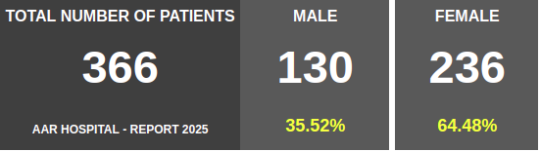
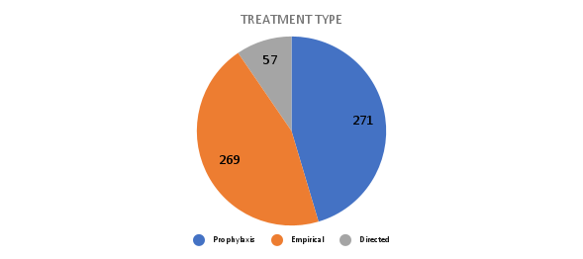
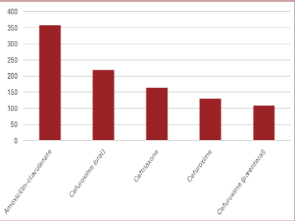
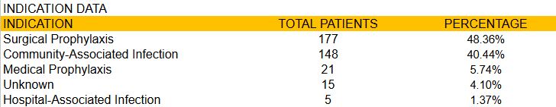
Retrospective File Review
Medical, Surgical, Pediatrics, ICU, & Obstetrics and Gynecology

Slide 5
Results
Key findings highlight suboptimal AMS functionality, with a score of 39%.
The facility heavily relied on empirical prescribing, with amoxicillin-clavulanate (26.93%) being the most prescribed antibiotic.
Surgical prophylaxis was the most common indication for antibiotic use (45.86%).
Microbiological testing rates were alarmingly low at 17.5%, with blood cultures being the most frequently requested (29.69%).
Adherence to treatment guidelines was inconsistent, with only 19.8–20% of cases undergoing microbiological confirmation before therapy.
Antibiotic de-escalation relied predominantly on clinical response (74% of cases) rather than laboratory data (4%).
The laboratory assessment revealed moderate scores (75–77%) but identified critical weaknesses, including outdated antibiograms.

Slide 6
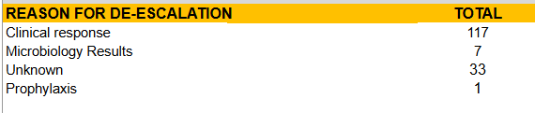
Adherence to Treatment Guidelines
AVERAGE NO. OF ANTIBIOTICS PER PATIENT
1 Antibiotic 186-52.5%
2 Antibiotics 145 -41%
3 Antibiotics 23 -6.5%
Cultures were done in 19.8% (21 out of 108) of the cases, mostly blood cultures (31%).
De-escalation majorly due to clinical response

Slide 7
Knowledge, Attitude & Practice (KAP)
Assessing Practice

Slide 8
Knowledge, Attitude & Practice (KAP)
Key informant interviews further exposed systemic challenges, including high rates of pre-admission antibiotic use (50–90%), unregulated over-the-counter sales, and hierarchical prescribing practices influenced by senior consultants.
Healthcare workers demonstrated understanding of AMS principles (mean scores: 6.68–7/10).
A total of 199 patients were classified as having received misused or incorrectly administered antibiotics. The estimated drug cost per patient in such cases was approximately USD 22.80

Slide 9
Recommendations
I. Strengthen AMS Programs
Train healthcare workers on AMS
Regular multidisciplinary AMS ward rounds
Update treatment guidelines
Pharmacy audits/prescription audits and feedback.
II. Improve Infection Prevention and Control (IPC)
Enhance policies to improve IPC in the facilities
Periodic environmental swabbing and audits

Slide 10
Recommendations 2
III. Enhance Diagnostic and Laboratory Support
Strengthen microbiology capacity - equipment, reagents, and sample collection bottles
Establish hospital antibiogram (with regular updates)
IV. Strengthen Policy and Regulation
Improve reporting of HAIs, AMR, and patient outcomes
Develop a surgical protocol for guided patient management

Slide 11
Acknowledgement
The AAR Hospital Leadership, Management & staff
The Aga Khan University team
LifeArc

Slide 12
THANK YOU.

